Slide 1
Distributed System
Introduction

Slide 2
Outline
General Course Information
Introduction

Slide 3
Things you should know
See your syllabus

Slide 4
What This Course is Really About
Distributed Systems
How to Design Algorithms for them
How to Design The Systems
How they work in real life
How to build real distributed systems
Principles
Design
Theory

Slide 5
Distributed system distributed computing
Early computing was performed on a single processor. Uni-processor computing can be called centralized computing.
A distributed system is a collection of independent computers, interconnected via a network, capable of collaborating on a task.
Distributed computing is computing performed in a distributed system.

Slide 6
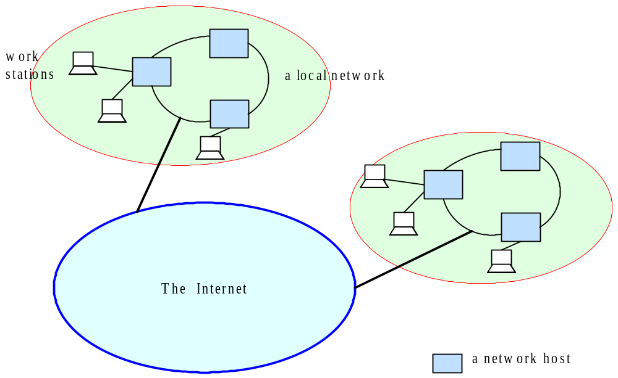
Distributed Systems

Slide 7
Can you name some examples of Operating Systems?
The one you use

Slide 8
Can you name some examples of Operating Systems?
…
Linux WinXP Vista 7/8 Unix FreeBSD Mac OSX
2K Aegis Scout Hydra Mach SPIN
OS/2 Express Flux Hope Spring
AntaresOS EOS LOS SQOS LittleOS TINOS
PalmOS WinCE TinyOS iOS
…

Slide 9
What is an Operating System?
Definition
Characteristics
Functionalities

Slide 10
What is an Operating System?
User interface to hardware (device driver)
Provides abstractions (processes, file system)
Resource manager (scheduler)
Means of communication (networking)
…

Slide 11
FOLDOC definition
(FOLDOC = Free On-Line Dictionary of Computing)
Operating System - The low-level software which handles the interface to peripheral hardware, schedules tasks, allocates storage, and presents a default interface to the user when no application program is running.
Wikipedia definition
An operating system (OS) is system software that manages computer hardware, software resources, and provides common services for computer programs.

Slide 12
Can you name some examples of
Distributed Systems?
What you consider when you pick them?

Slide 13
Can you name some examples of
Distributed Systems?
Client-Server (NFS)
The Web
The internet
A wireless network
DNS
Gnutella or BitTorrent (peer to peer overlays)
A “cloud”, e.g., Amazon EC2/S3, Microsoft Azure
A datacenter, e.g., NCSA, a Google datacenter, AWS

Slide 14
What is a Distributed System??
Definition
Characteristics
Functionalities

Slide 15
FOLDOC definition
A collection of (probably heterogeneous) automata whose distribution is transparent to the user so that the system appears as one local machine. This is in contrast to a network, where the user is aware that there are several machines, and their location, storage replication, load balancing and functionality is not transparent. Distributed systems usually use some kind of client-server organization.
Wikipedia definition
A distributed system is a system whose components are located on different networked computers, which communicate and coordinate their actions by passing messages to one another from any system.

Slide 16
Textbook definitions
A distributed system is a collection of independent computers that appear to the users of the system as a single computer.
[Andrew Tanenbaum]
A distributed system is several computers doing something together. Thus, a distributed system has three primary characteristics: multiple computers, interconnections, and shared state.
[Michael Schroeder]
Notes:
Contradictions:
uh, doesn’t each computer need to know about a few other computers in the system (somewhere deep down there in the RAM)?
If computers don’t exchange any information and make no progress, would this count as a distributed system?

Slide 17
Unsatisfactory
Why are these definitions short?
Why do these definitions look inadequate to us?
Because we are interested in the insides of a distributed system
  design and implementation
  Maintenance
  Algorithmics (“protocols” or “distributed algorithms”)

Slide 18
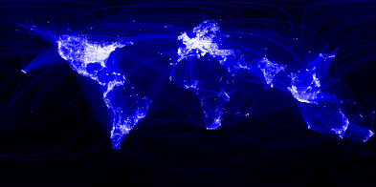
Which is a Distributed System – (A) or (B)?
(A)
(A) Facebook Social Network Graph among humans
Source: https://www.facebook.com/note.php?note_id=469716398919

Slide 19
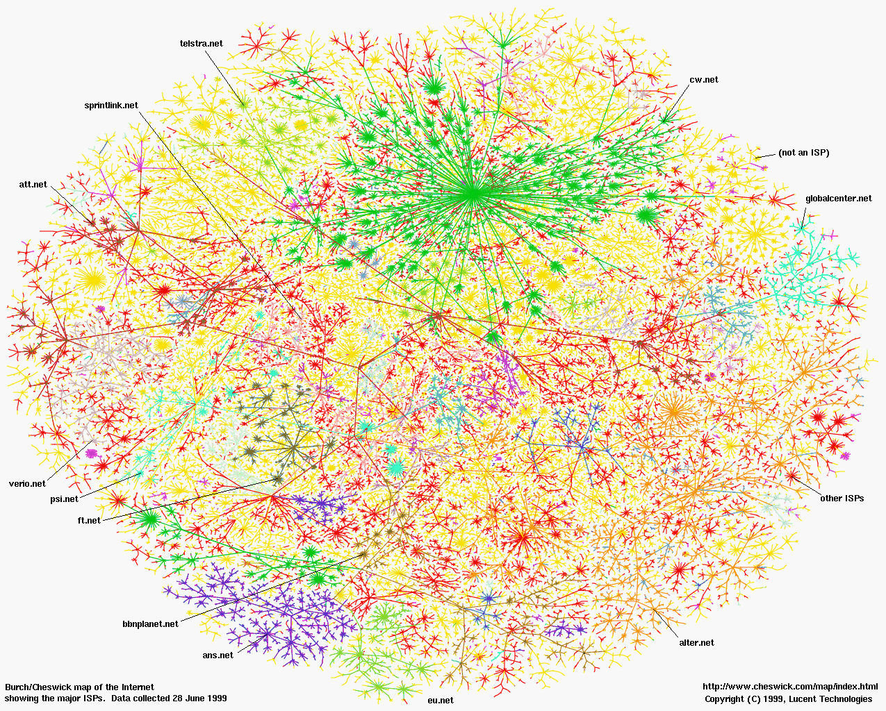
(B)
(B) The internet (Internet Mapping Project, color coded by ISPs)

Slide 20
A working definition for us
A distributed system is a collection of entities, each of which is autonomous, programmable, asynchronous and failure-prone, and which communicate through an unreliable communication medium.
Entity=a process on a device (PC)
Communication Medium=Wired or wireless network
Our interest in distributed systems involves
  design and implementation, maintenance, algorithmics
Notes:
Designers and progammers interested in : algorithmics, maintenance.
(informal definition, for us programmers of distributed systems)
Ok: peer to peer systems
Contradiction: a computer without ROM or disk drives that needs to boot over the network. Is a collection of these computers a distributed system?

Slide 21
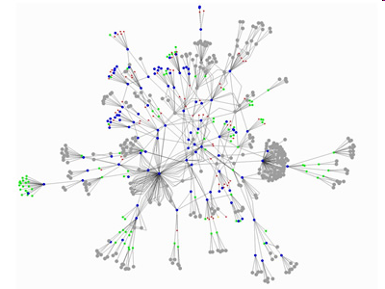
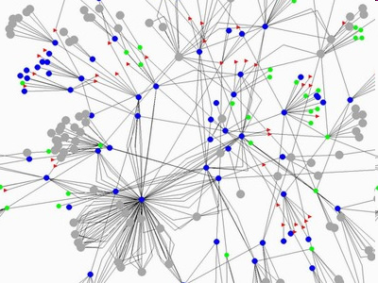
Gnutella Peer to Peer System
P2P network protocol
Source: GnuMap Project

Slide 22
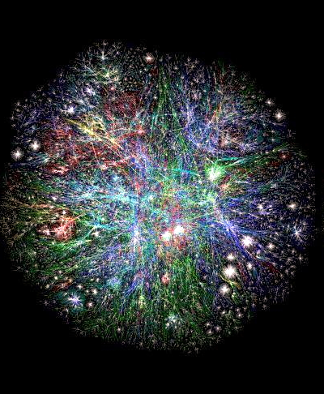
Web Domains (DNS)
Source: http://www.vlib.us/web/worldwideweb3d.html
C-S mode protocol

Slide 23
The internet – Quick Refresher
Underlies many distributed systems.
A vast interconnected collection of computer networks of many types.
Intranets – subnetworks operated by companies and organizations.
Intranets contain LANs (local area networks).
WAN – wide area networks, consists of subnets (intranets, LANs, etc.)
ISPs – Internet Service Providers. Companies that provide modem links and other types of connections to users.
Intranets (actually the ISPs’ core routers) are linked by backbones – network links of large bandwidth, such as satellite connections, fiber optic cables, and other high-bandwidth circuits.
MAN - Metropolitan Area Networks
Mobile/wireless extension

Slide 24
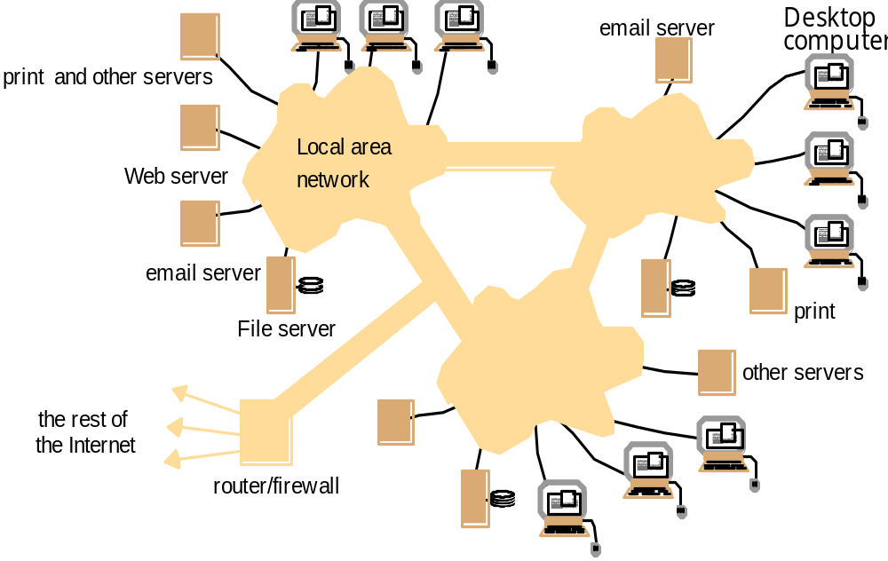
An Intranet & a distributed system
Running over this Intranet is a distributed file system
A portion of Internet that is separately administered & supports internal sharing of
resources (file/storage systems and printers)

Slide 25
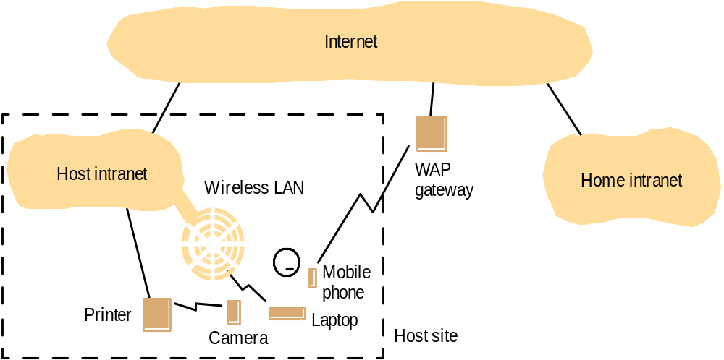
Mobile and ubiquitous computing: portable and handheld devices in a distributed system
Support continued access to Home intranet resources via wireless and provision to utilise resources (e.g., printers) that are conveniently located (location-aware computing).
Notes:
We are at a point where many of our devices have short (BT) and medium range (WiFi) wireless - camera, PDA, mobile, laptop, etc
They are creating ad-hoc DS in our homes!
Bonjour / Zeroconf enable location aware, ad-hoc distributed computing - find local file servers, printers, other users via advertising messages
A WAP gateway sits between mobile devices using the WAP protocol and the World Wide Web
Wireless Application Protocol (commonly referred to as WAP) is an open international standard[1] for application layer network communications in a wireless communication environment.

Slide 26
“The network really is the computer.”
Tim O’Reilly, in an address at 6/2000 Java One:
“By now, it's a truism that the Internet runs on open source. Bind, the Berkeley Internet Name Daemon, is the single most mission critical program on the Internet, followed closely by Sendmail and Apache, open source servers for two of the Internet's most widely used application protocols, SMTP and HTTP.”
Early “killer apps”:
- usenet: distributed bulletin board
- email
Recent “killer apps”:
- the web
- cloud computing/edge computing
- mobile computing

Slide 27
Computers in a Distributed System
Workstations: computers used by end-users to perform computing
Server machines: computers which provide resources and services
Personal Assistance Devices: handheld computers connected to the system via a wireless communication link.

Slide 28
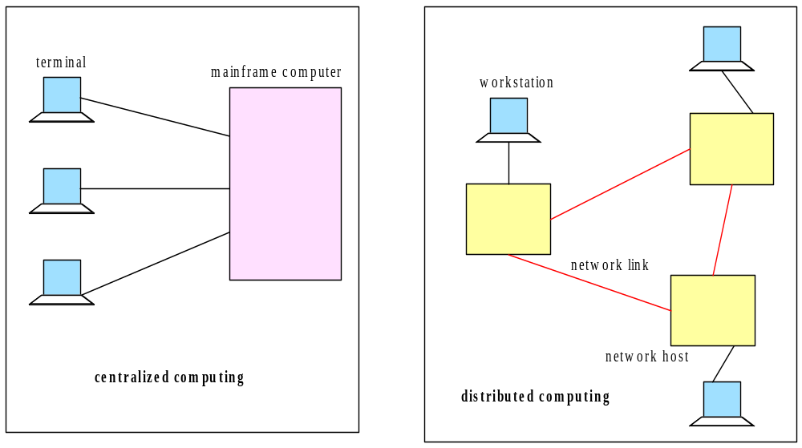
Centralized vs. Distributed Computing

Slide 29
Why distributed system?

Slide 30
Why distributed computing?
Economics: distributed systems allow the pooling of resources, including CPU cycles, data storage, input/output devices, and services.
Reliability: a distributed system allow replication of resources and/or services, thus reducing service outage due to failures.
Possibility: For applications with physically distributed components
The Internet has become a universal platform for distributed computing.

Slide 31
Advantages
The advantages of distributed computing:
The affordability of computers and availability of network access
Resource sharing
Scalability
Fault Tolerance

Slide 32
Disadvantages
The disadvantages of distributed computing:
Multiple Points of Failures: the failure of one or more participating computers, or one or more network links, can spell trouble.
Security Concerns: In a distributed system, there are more opportunities for unauthorized attack.

Slide 33
Business Example and Challenges
Online bookstore (e.g. in the World Wide Web)
  Customers can connect their computer to your computer (web server):
    Browse your inventory
    Place orders
    …
This example Adopted from Torbin Weis, Berlin University of Technology
Notes:
Amazon.com is the biggest example of this
They would typically service tens of thousands of customers at a time.
Would one server be enough to handle this example? No!
Amazon.com is inherently distributed - Warehouses locateed across the country and globe, many international stores (US, UK, Germany, Japan). Well suited to a distributed approach, both physically and logically.

Slide 34
Business example – challenges I
What if
  Your customer uses a completely different hardware? (PC, MAC,…)
  … a different operating system? (Windows, Unix,…)
  … a different way of representing data? (ASCII, EBCDIC,…)
  Heterogeneity
Or
  You want to move your business and computers to the Caribbean (because of the weather)?
  Your client moves to the Caribbean (more likely)?
  Distribution transparency
Notes:
As a business that uses a DS approach, they face many challenges:
Hardware: PC, Mac, Sun,
OS: Windows, Linux, MacOS, FreeBSD
Data: Different formats and ways of representing the same info
Move the business: Complex when infrastructure is distributed
Clients move: You need to make sure they are still well services, have the same experience no matter where they are (ie. Caching, Load Bal.)

Slide 35
Business example – challenges II
What if
  Two customers want to order the same item at the same time?
  Concurrency
Or
  The database with your inventory information crashes?
  Your customers computer crashes in the middle of an order?
  Fault tolerance
Notes:
As DS designers you need to handle these common events - you cannot assume that they won’t happen!
Concurrency: Access to a shared resource must be synchronised so that data remains consistent (I.e. via semaphores/locks)
Faults/Failures: Independent failures shouldn’t cripple the whole system. Design to deal with failures as gracefully as you can.

Slide 36
Business example – challenges III
What if
  Someone tries to break into your system to steal data?
  … sniffs for information?
  … your customer orders something and doesn’t accept the delivery saying he didn’t?
  Security
Or
  You are so successful that millions of people are visiting your online store at the same time?
  Scalability
Notes:
Security: Firewalls and other filtering methods can limit attackers ability to break in.
Encryption can protect the integrity of data sent between clients and servers.
Non-repudiation techniques such as digital signatures can ensure customer cannot lie about their activities.
Scalability: How can we scale out. Does our DS design allow this?

Slide 37
Business example – challenges IV
When building the system…
  Do you want to write the whole software from scratch (network, database,…)?
  What about updates, new technologies?
  Reuse and Openness (Standards)
Notes:
We don’t have to reinvent the wheel, there are many tools that can help:
E.g. Can implement online book store via LAMP stack or off the shelf system.
Can use J2EE to handle many key aspects of DS design (encryption, scalability, message passing, etc).
Reuse and open standards help us out a lot. E.g. Corba via C or Java.

Slide 38
Heterogeneity
Heterogeneous components must be able to interoperate
  Operating systems
  Hardware architectures
  Communication architectures
  Programming languages
  Software interfaces
  Security measures
  Information representation
Notes:
Different OS: Windows, MacOS, Linux, BSD
Hardware: Intel, PowerPC, Sparc, ARM
Comm. Arch’s:
Programming Languages: C/C++, Java, Perl, Python, Ruby, etc
Software interfaces: Common interfaces are needed (RPC, WS)
Security measures: Need to talk same language (3DES, Blowfish, etc)

Slide 39
Distribution Transparency I
Distribution should be hidden from the user as much as possible
  To hide from the user and the application programmer of the separation/distribution of components, so that the system is perceived as a whole rather than a collection of independent components.
Access transparency
  Access to local or remote resources is identical
  E.g. Network File System
Location transparency
  Access without knowledge of location
  E.g. separation of domain name from machine address.
Failure transparency
  Tasks can be completed despite failures
  E.g. message retransmission, failure of a Web server node should not bring down the website.
Notes:
Access transparency: Most modern OS provide this for us. Once remote FS is mounted, we work with it like a local drive. R drive.
Location transparency: DNS gives us this. If server moves and changes IP, DNS will always point to current location (with some limits)
Failure transparency: Can be solved by good design - message retransmission, hot spares, self healing architectures.

Slide 40
Distribution Transparency II
Replication transparency
  Access to replicated resources as if there was just one. And provide enhanced reliability and performance without knowledge of the replicas by users or application programmers.
Migration (mobility/relocation) transparency
  Allow the movement of resources and clients within a system without affection the operation of users or applications.
  E.g. switching from one name server to another at runtime; migration of an agent/process form one node to another.
Notes:
Replication transparency: DNS can achieve this. Eg: google.com goes
To {host1.google.com, host2.google.com, …hostn.google.com, etc}
User is unaware they have been redirected.
Migration: Server migration is well covered by DNS. DS Services should be created to not be confused when client rapidly changes location (e.g. 3g user, or wifi changing hotspots).

Slide 41
Distribution Transparency III
Concurrency transparency
  A process should not notice that there are other sharing the same resources
Performance transparency:
  Allows the system to be reconfigured to improve performance as loads vary.
  E.g., dynamic addition/deletion of components. switching from linear structures to hierarchical structures when the number of users increase.
Scaling transparency:
  Allows the system and applications to expand in scale without change to the system structure or the application algorithms.
Application level transparencies:
  Persistence transparency
    Masks the deactivation and reactivation of an object
  Transaction transparency
    Hides the coordination required to satisfy the transactional properties of operations
Notes:
Concurrency transparency: The fact that many users are competing for one resource can be hidden by good scheduling
Performance / Scaling transperency: Inter-related, DS should be agile enough to expand when load increases and contract during quiet times.
This requires careful initial design.
Application level: Persistance for end users, they should not need to login constantly. Transactions should happen without undue delay

Slide 42
Fault tolerance
Failure: an offered service no longer complies with its specification
Fault: cause of a failure
Fault tolerance: no failure despite faults. Failure of a component (partial failure) should not result in failure of the whole system
Notes:
Failure: service can be no longer available, or be so slow as to be unusable.
Fault: the component that is not functioning correctly.
Fault tolerence: programmed to handle failures if and when they happen, in a graceful way that hides them from users.

Slide 43
Fault tolerance mechanisms
Fault detection
  Checksums, heartbeat, …
Fault masking
  Retransmission of corrupt messages, redundancy, …
Fault toleration
  Exception handling, timeouts,…
Fault recovery
  Rollback mechanisms,…
Notes:
Detection: Checksum, check integrity of messages (Hash, md5).
Masking: TCP handles retransmission, we can add our own application level fault masking for better reliability.
Toleration: Handle faults, delays gracefully.
Recovery: If something bad DOES happen, hopefully we know about it (!!) and we can roll back to a known good state.

Slide 44
Scalability
System should work efficiently with an increasing number of users
System performance should increase with inclusion of additional resources.
Challenges of designing scalable distributed systems:
  Cost of physical resources
    Cost should linearly increase with system size
  Performance Loss
  Preventing software resources running out:
    Numbers used to represent Internet address (32 bit->64bit)
  Avoiding performance bottlenecks:
    Use decentralized algorithms (centralized DNS to decentralized).
Notes:
Scalability can be difficult to achieve depending on application domain.
Services can receive huge increases in traffic (e.g. when featured on slashdot/digg, etc).
We want to be able to add commodity (cheap) servers to increase cap.
Static file serving: Add more servers, adjust DNS
Dynamic web page serving: Add more servers, replicate and synchronise (cluster) back-end DB, adjust DNS

Slide 45
Concurrency
Shared access to resources must be possible
Provide and manage concurrent access shared resources:
  Fair scheduling
  Preserve dependencies (e.g. distributed transactions)
  Avoid deadlocks
Notes:
Fair scheduling ensures everyone gets a turn on a popular resource
Dependencies occur for transactions. Eg. Buy a book with Credit Card, check that user has sufficient funds before finalising the transaction
Deadlocks can occur when two users hold a resource, and they are waiting for each other to release their respective resource.

Slide 46
Openness and Interoperability
Interfaces should be publicly available to ease adding new components
Open system:
"... a system that implements sufficient open specifications for interfaces, services, and supporting formats to enable properly engineered applications software to be ported across a wide range of systems with minimal changes, to interoperate with other applications on local and remote systems, and to interact with users in a style which facilitates user portability" (Guide to the POSIX Open Systems Environment, IEEE POSIX 1003.0).
Open spec/standard developers - communities:
  ANSI, IETF, W3C, ISO, IEEE, OMG, Trade associations,...
Notes:
ANSI C - standard, portable way of programming C
W3C - defines key protocols like HTML, Web Services, SOAP, CSS
IEEE - defines standards like 802.1a/b/g/n
Standards are important or we’d never get anything done.

Slide 47
Security I
The resources are accessible to authorized users and used in the way they are intended.
  Confidentiality
    Protection against disclosure to unauthorized individual.
    E.g. ACLs (access control lists) to provide authorized access to information.
  Integrity
    Protection against alternation or corruption.
    E.g. changing the account number or amount value in a money order
Notes:
Confidentiality: Ensure that user’s information is not comprised or exposed
ACL ensures that only certain people can access service, and can be restricted to certain locations (e.g. IP’s, subnets)
Integrity: We can encrypt data transferred, and/or perform checksums/hash to verify integrity of message.

Slide 48
Security II
  Availability
    Protection against interference targeting access to the resources.
    E.g. denial of service (DoS, DDoS) attacks
  Non-repudiation
    Proof of sending / receiving an information
    E.g. digital signature
Notes:
Availability: Maintaining uptime is crucial to given end-users confidence in your service. Study has shown uses wait only a few seconds before giving up on a loading webpage. That can cost $$$$$$
Need to protect against DoS/DDoS… attack that imitates normal access of the service/.
Non-repudiation: Proof that a user sent a particular message or made transaction - they cannot deny doing so after the fact.

Slide 49
Security mechanisms
Encryption
  E.g. Blowfish, RSA
Authentication
  E.g. password, public key authentication
Authorization
  E.g. access control lists
Notes:
Blowfish is a general-purpose encryption algorithm, intended as a replacement for the aging DES
RSA is a public key encryption algorithm that is suitable for signing as well as encryption
Authentication can be via standard user/pass or public key auth
Access Control Lists can control who can access a service, which parts of the service they can use and where they access it from.

Slide 50
Topics Covered in this Course
Concepts and system models
Networking and internetworking
Inter-process communication
Socket API and Client-server paradigm
Distributed objects
Clocks and time
Mutual exclusion
Fault tolerance
Distributed algorithms
Advanced topics
  Cloud computing
  Blockchain

Slide 51
HW #1
Concepts, definitions of
  Monolithic computing
  Distributed computing
  Parallel computing
  Cooperative computing
  …
Real world examples of the above computing forms
Please submit in BrightSpace

Slide 52
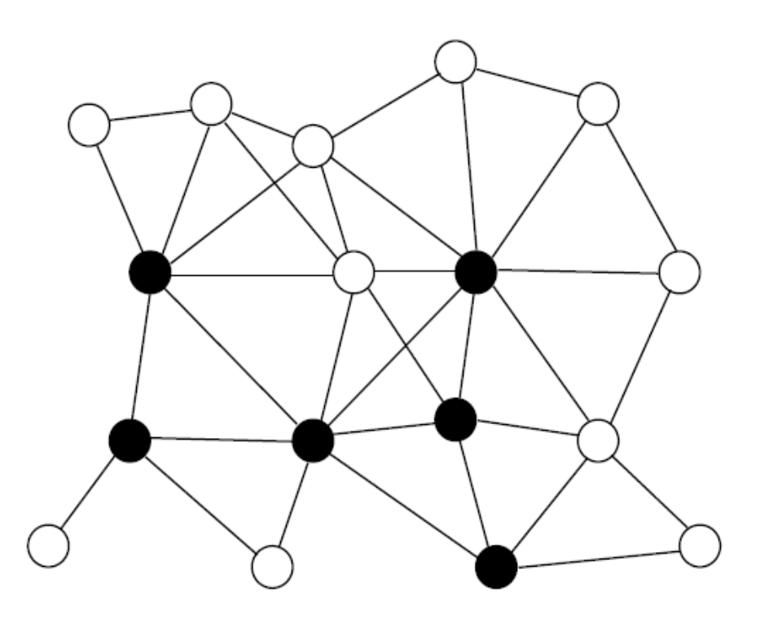
An example about distributed/localized algorithm

